Slide 1
Chapter 6
Defining Behaviors and Detecting Collisions

Slide 2
This Chapter
Start thinking about behavior
Implement autonomous, controlled, gradual turning and target-locked chasing behaviors
Needs for collision detection
Simple: Axis-Aligned BBOX
Collide textured objects accurately
Per-Pixel-accurate collision
Understand algorithm and efficiency
Derive and implement general solution

Slide 3
Review: Where are we?
Chapter 2+3: Hides Drawing
GLSL Shader, SimpleShader, Renderable
Chapter 4: Utility components
Loop, Keyboard input
Scene object: API interface
Resources management, Audio
Chapter 5: Drawing of “objects” as textures and animation
TextutreShader and TextureRenderable
Sprite animation
Font
Need: Abstract behavior wrapping

Slide 4
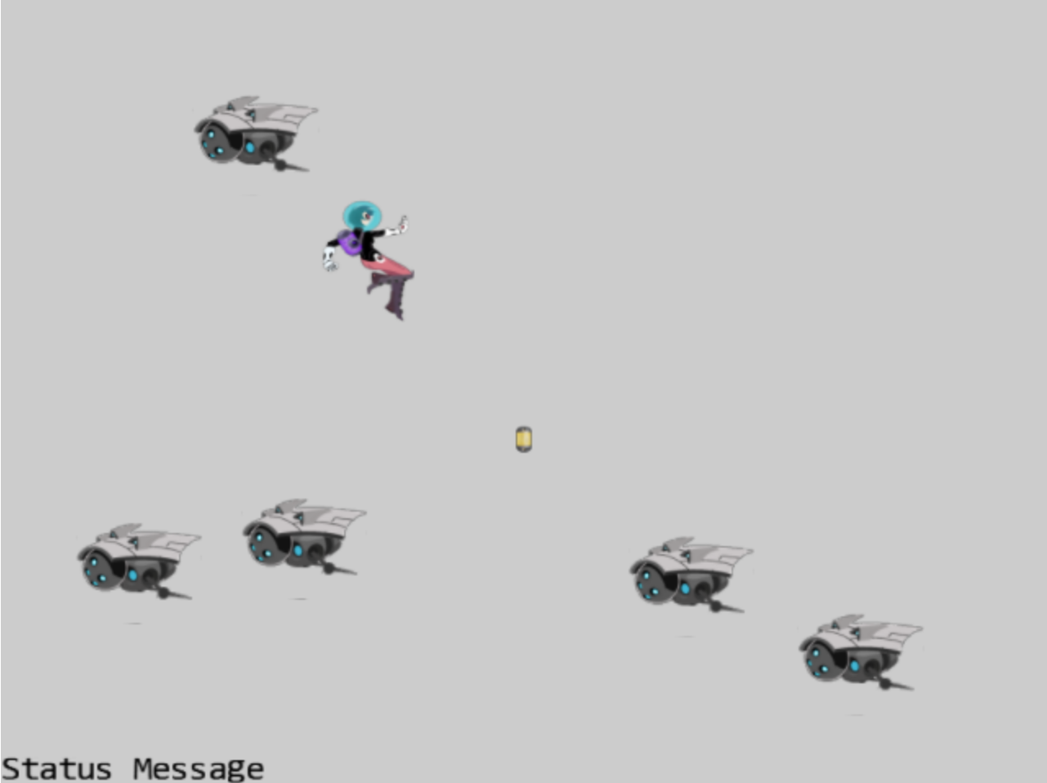
6.1: GameObjects Project

Slide 5
6.1: Goals
Define the GameObject:
To begin abstract/hide behavior implementation
Clean up drawing interface: should pass in Camera

Slide 6
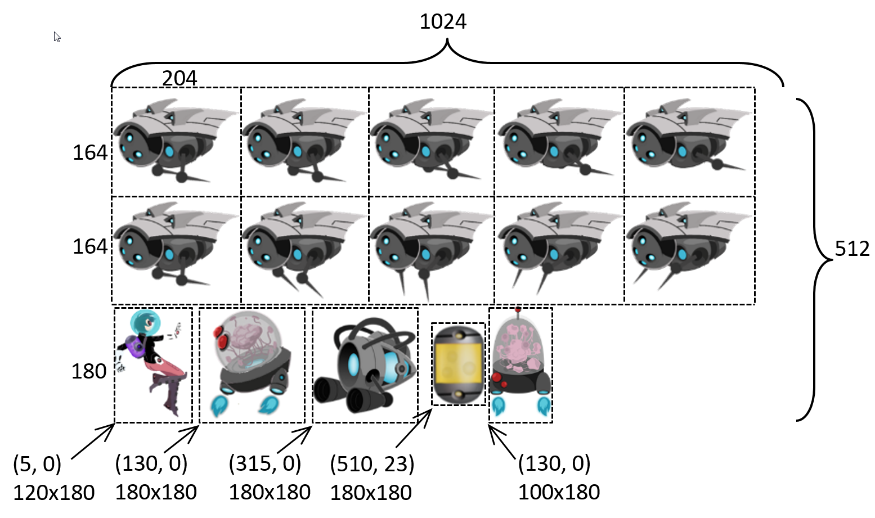
New sprite element

Slide 7
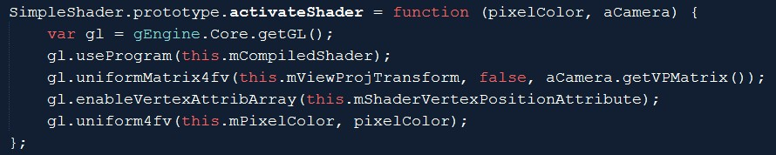
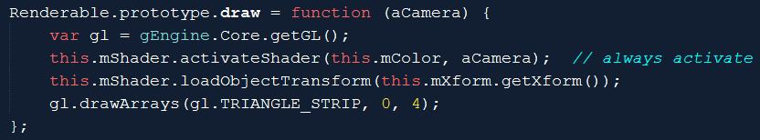
Draw: with a Camera (instead of vpMatrix)

Slide 8
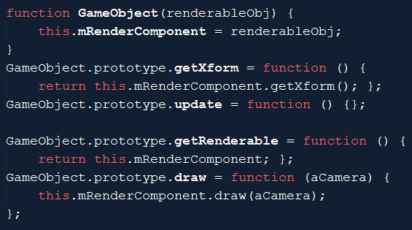
GameObject: capturing behaviors!
update()
Implements object behaviors
Has a renderable
Can be drawn
Has a xform
Can be maniuplated

Slide 9
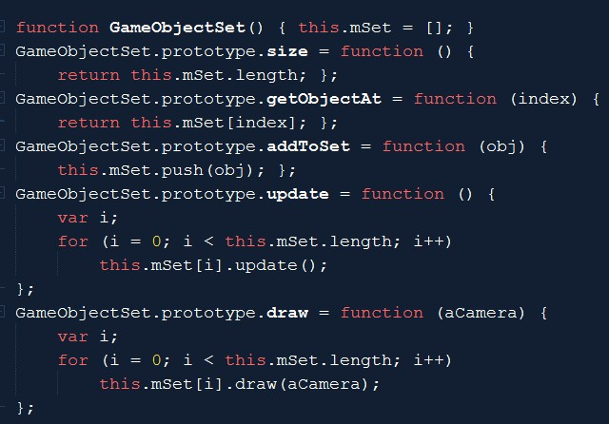
GameObjectSet:
Set of GameObjects
Set maintenance
Add/Size/Access
GameObjects support
update/draw

Slide 10
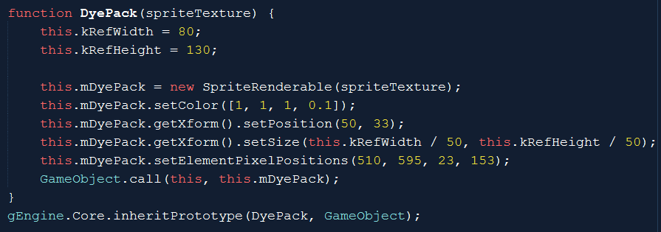
Work with GameObject
Custom object: DyePack

Slide 11
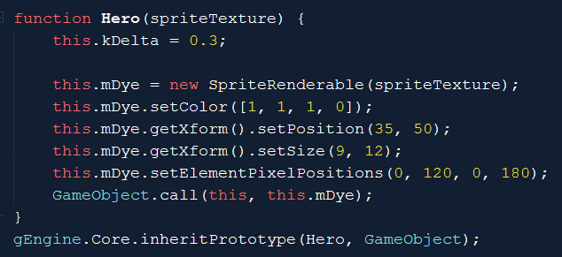
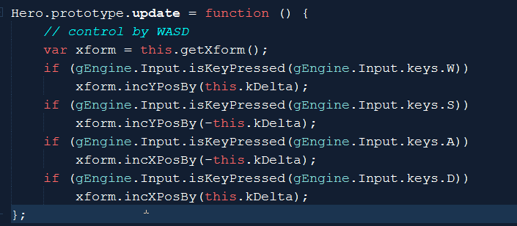
The Hero
The Definition
Behavior!
Hidden from MyGame
Avoid code clustering in MyGame

Slide 12
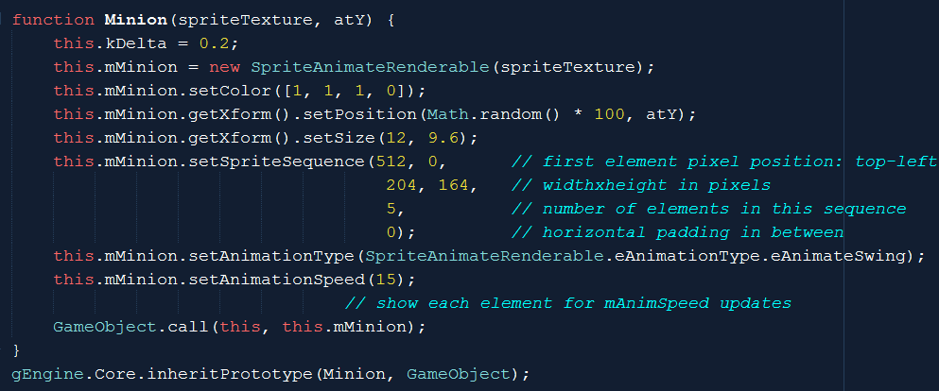
Minion

Slide 13
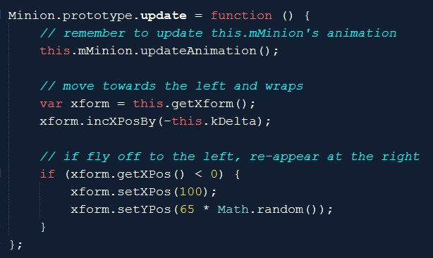
Minion’s interesting behavior
MyGame: no need to have any knowledge of how minion’s behave!

Slide 14
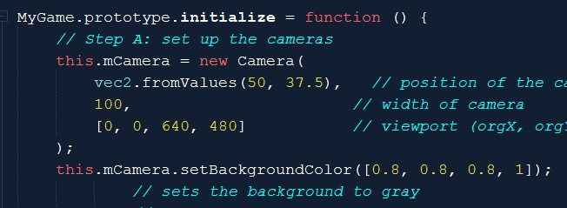
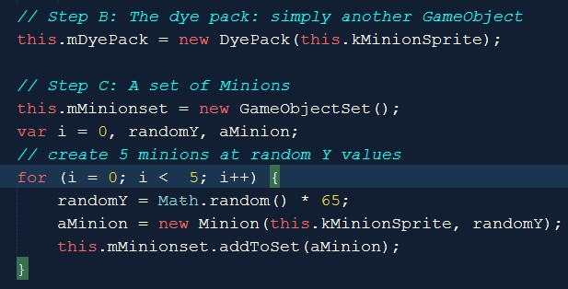
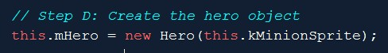
MyGame::initialization()

Slide 15
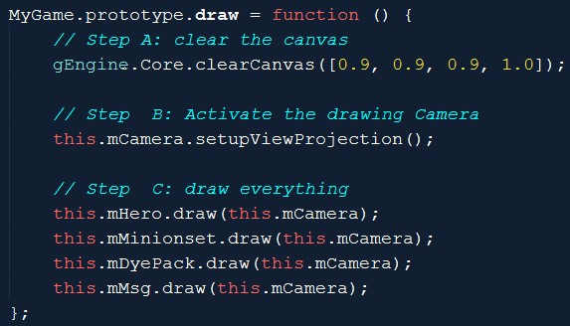
MyGame draw()
draw()
Init camera
Pass camera to GameObjects

Slide 16
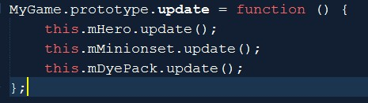
MyGame update()
Core of game logic:
Each object updates state
No object interact:
So, that’s that!
Notice:
MyGame does not know anything about each object
Control/Behavior: all hidden inside each object
MyGame: will take care of interaction of objects (to come)!
For objects to interact: need to be aware of other objects!

Slide 17
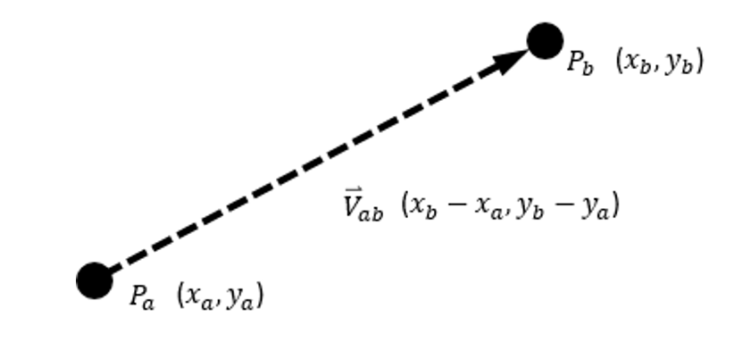
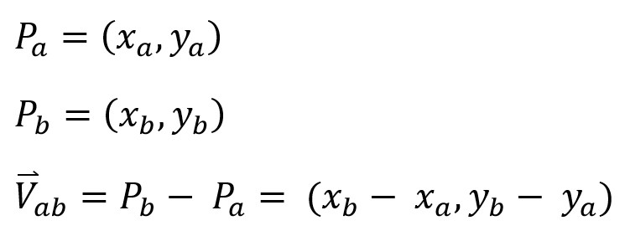
Vectors: Review
From point to point
Has a size
Magnitude, length, distance

Slide 18
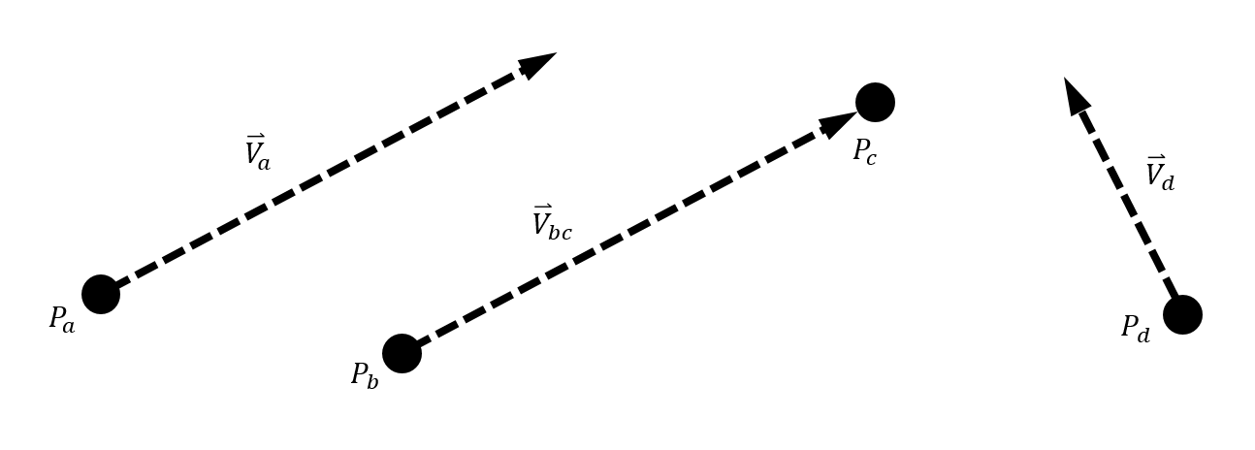
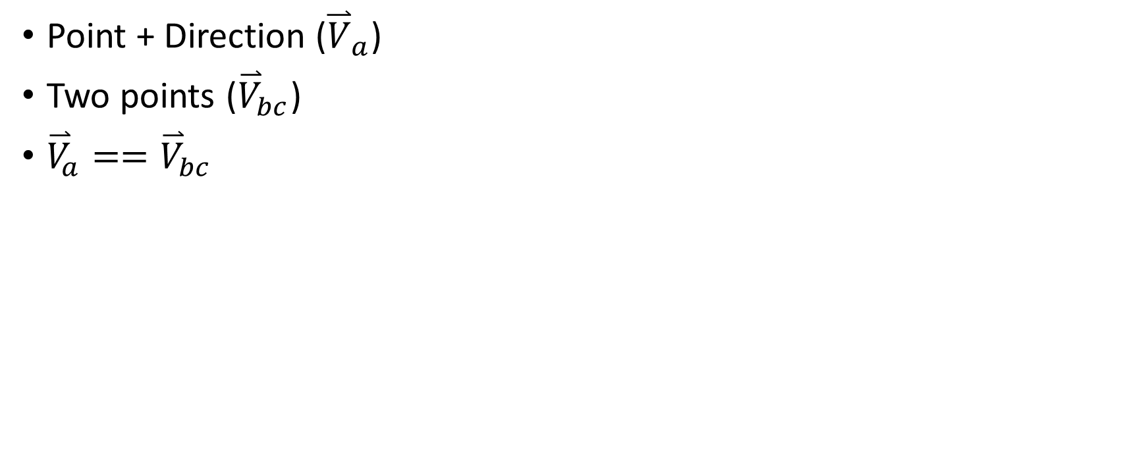
Vectors: direction and size
Point + Direction (${\overset{⃑}{V}}_{a}$)
Two points (${\overset{⃑}{V}}_{bc}$)
${\overset{⃑}{V}}_{a}=={\overset{⃑}{V}}_{bc}$

Slide 19
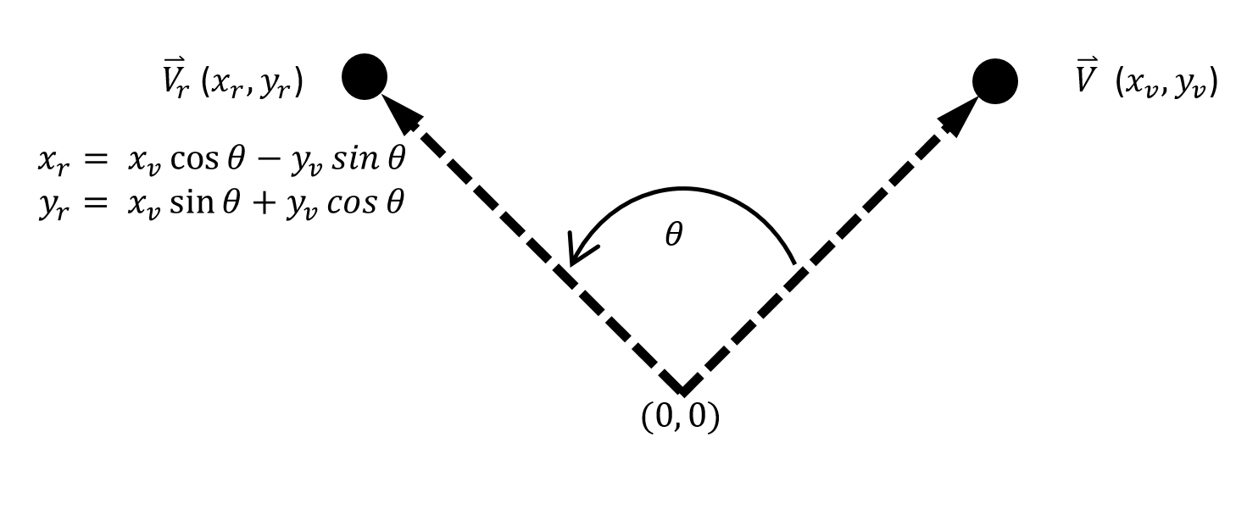
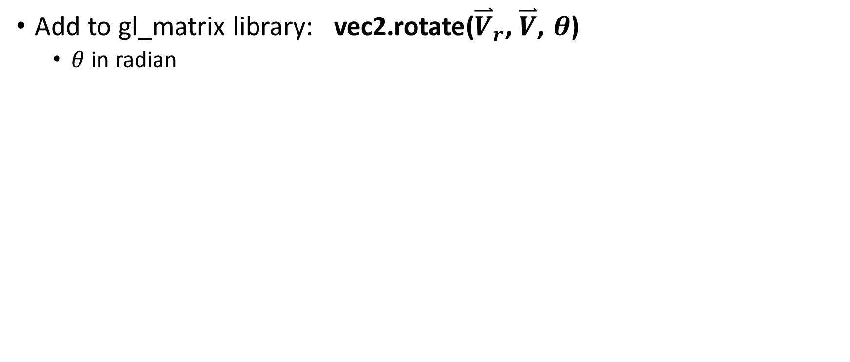
Vector: rotation
Add to gl_matrix library: vec2.rotate(${\overset{⃑}{V}}_{r}\text{,} \overset{⃑}{V}$, $θ$)
$θ$ in radian

Slide 20
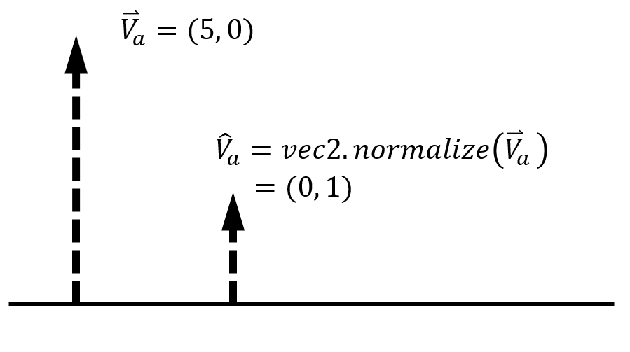
Vectors: normalization

Slide 21
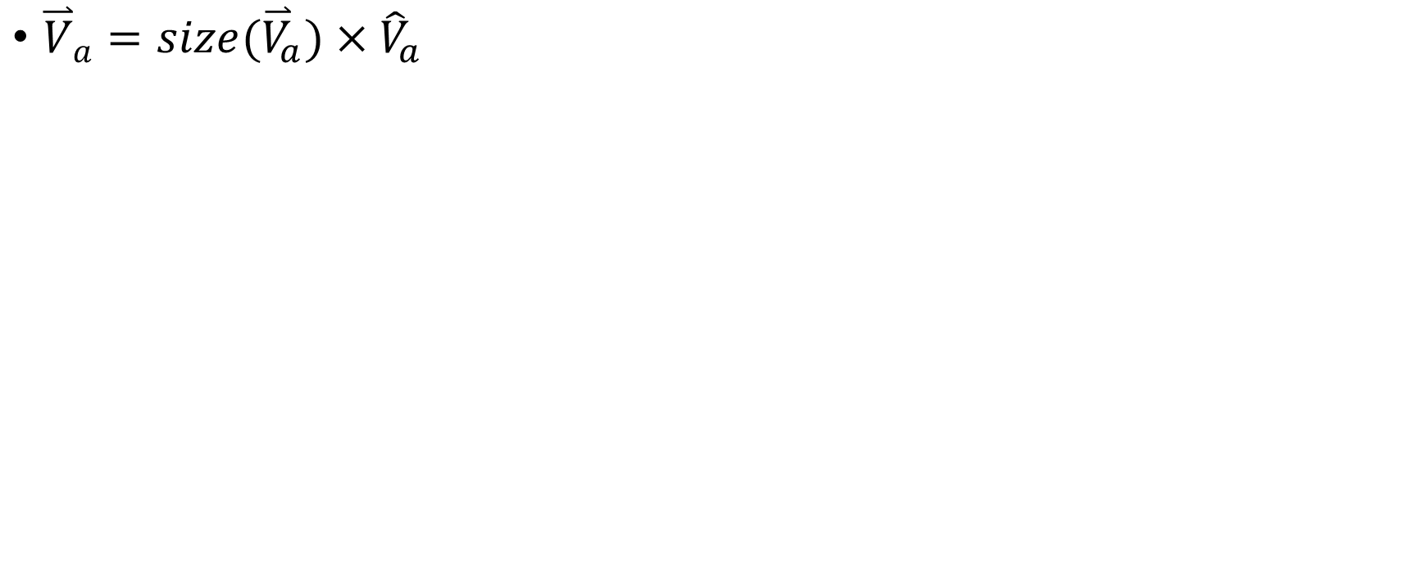
Vectors: normalization
${\overset{⃑}{V}}_{a}=size({\overset{⃑}{V}}_{a})×{\hat{V}}_{a}$

Slide 22

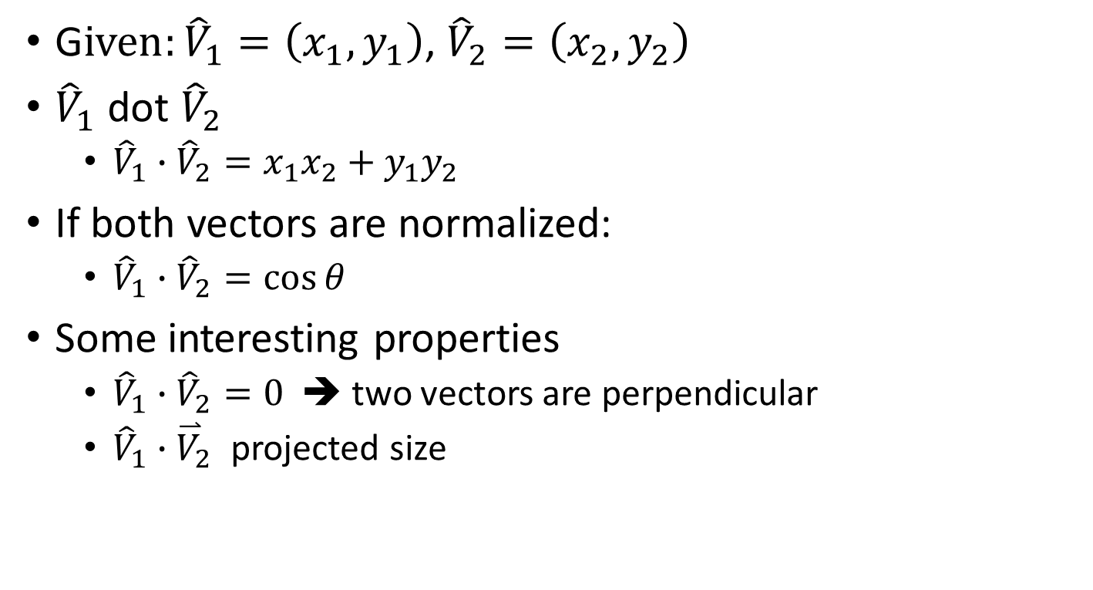
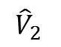
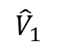
Vector: dot product
$${\hat{V}}_{1}$$
G$iven:{\hat{V}}_{1}=\left(x_{1},y_{1}\right)$, ${\hat{V}}_{2}=\left(x_{2},y_{2}\right)$
${\hat{V}}_{1}$ dot ${\hat{V}}_{2}$
${\hat{V}}_{1}∙{\hat{V}}_{2}={x_{1}x}_{2}+y_{1}y_{2}$
If both vectors are normalized:
${\hat{V}}_{1}∙{\hat{V}}_{2}=\cos{θ}$
Some interesting properties
${\hat{V}}_{1}∙{\hat{V}}_{2}=0$ ➔ two vectors are perpendicular
${\hat{V}}_{1}∙{\overset{⃑}{V}}_{2}$ projected size
$${\hat{V}}_{2}$$
$$θ$$

Slide 23
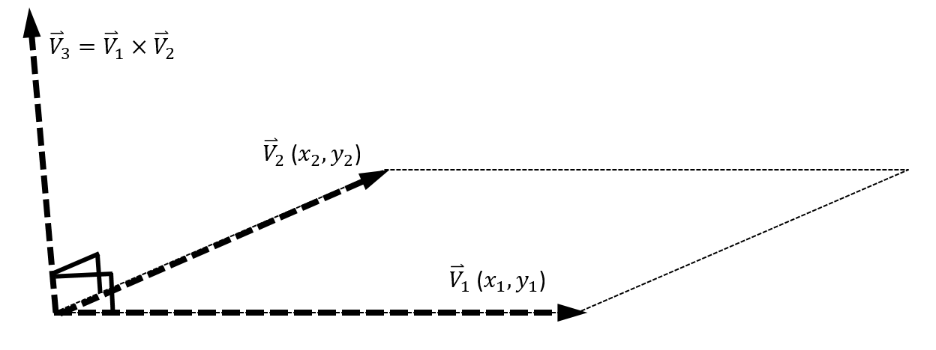
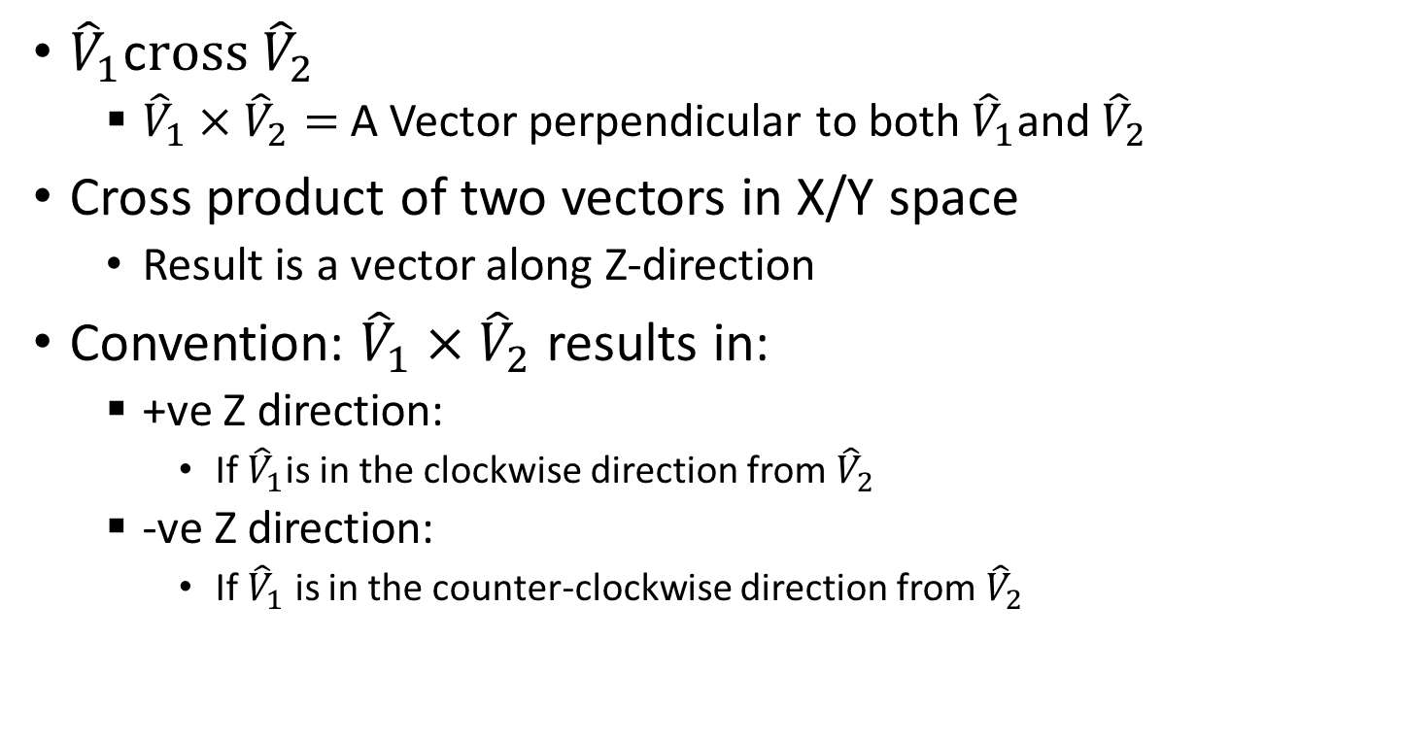
Vector: cross product
${\hat{V}}_{1}$c$ross {\hat{V}}_{2}$
${\hat{V}}_{1}×{\hat{V}}_{2}=$ A Vector perpendicular to both ${\hat{V}}_{1}$and${\hat{V}}_{2}$
Cross product of two vectors in X/Y space
Result is a vector along Z-direction
Convention: ${\hat{V}}_{1}×{\hat{V}}_{2}$ results in:
+ve Z direction:
If ${\hat{V}}_{1}$is in the clockwise direction from${\hat{V}}_{2}$
-ve Z direction:
If ${\hat{V}}_{1}$ is in the counter-clockwise direction from${ \hat{V}}_{2}$

Slide 24
Practice
I am traveling at v=(3, 4)
Is v a speed or velocity? And Why
How fast am I moving?
What is the direction I am moving towards?
If I were to look at my movement ONLY along the x-axis, how fast am I moving?
If I were to look at my movement ONLY along the direction: A=(0.707, 0.707), how fast am I moving?

Slide 25
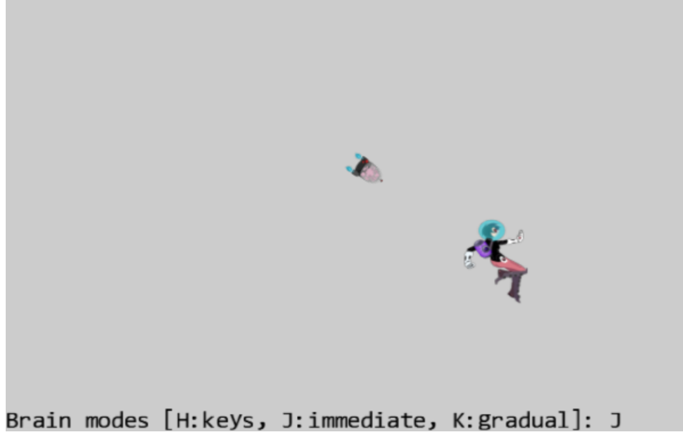
6.2: Front and Chase Project

Slide 26
6.2: Goals
work with velocity: as speed and direction
practice traveling along a predefined direction
implement chasing or home-in behavior

Slide 27
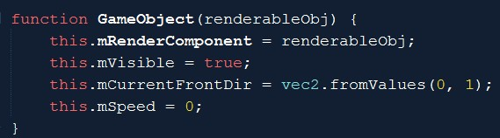

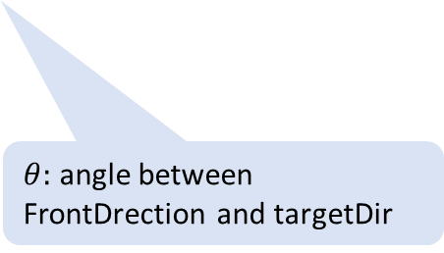
GameObject: initial state
$θ:$ angle between FrontDrection and targetDir
Initial front direction

Slide 28
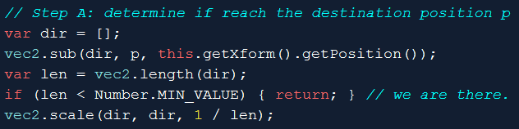
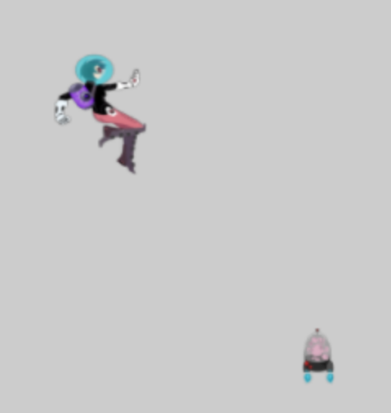
GameObject::rotateObjPointTo(p)
Position: p
dir: towards p
len (length of dir)
this.getXform().getPosition()

Slide 29
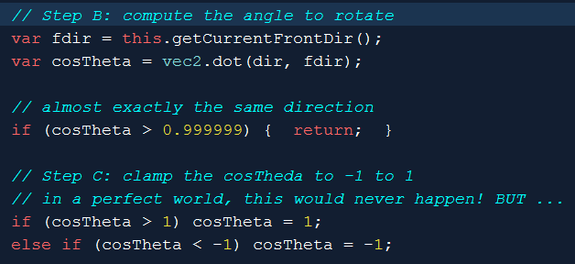
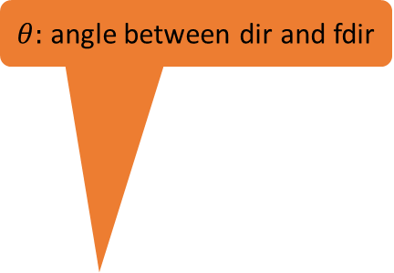
GameObject::rotateObjPointTo(p)
Position: p
$θ:$ angle between dir and fdir
dir: towards p
fdir: front of object
len (length of dir)
this.getXform().getPosition()

Slide 30
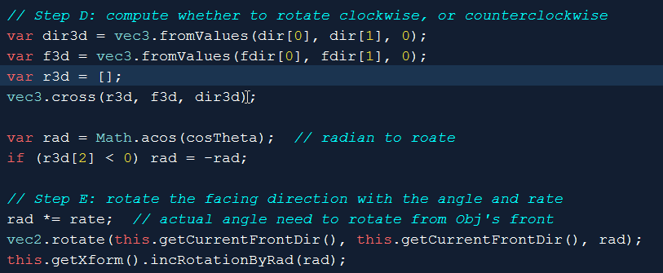
GameObject::rotateObjPointTo(p) cont …
this.getXform(): set rotation

Slide 31
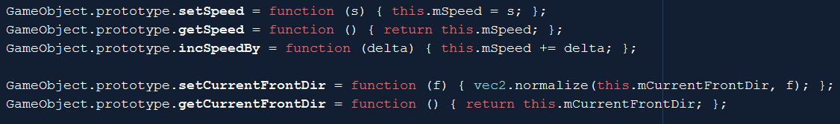
MyGame: set/get
Update speed
Set Front Dir: maintain normalized vector!

Slide 32
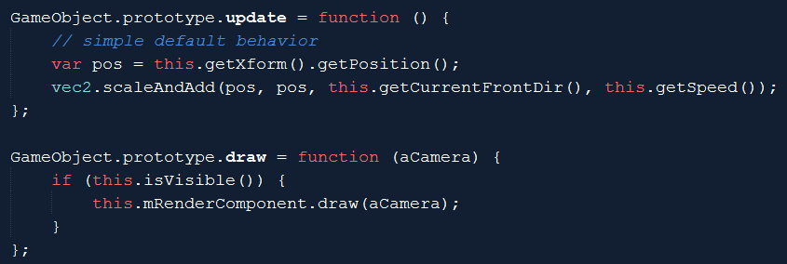
GameObject: update and draw

Slide 33
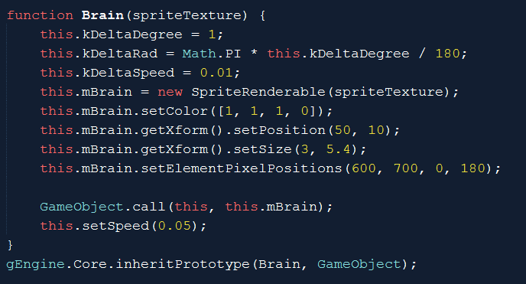
Testing rotate towards object: the Brain

Slide 34
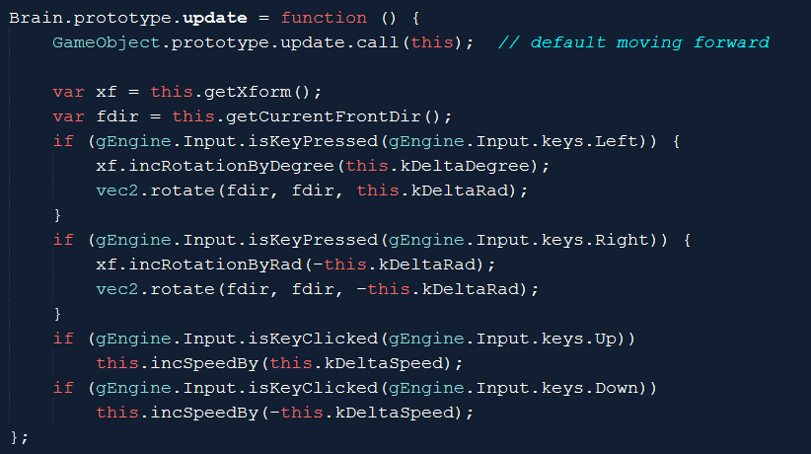
Brian: private behavior
Drive the brain
Change speed
Direction and Speed are independent

Slide 35
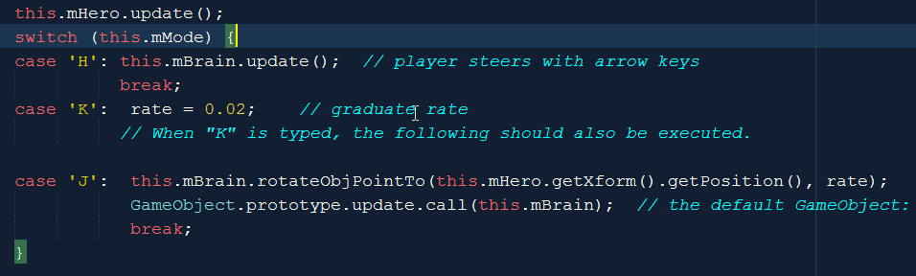
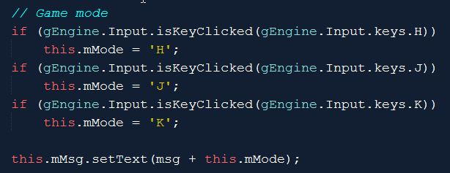
MyGame::update
Default is: 1.0

Slide 36
On GameObject::rotateObjPointTo(p)
In each case, why are we returning?
Why are we comparing to such strange floating point numbers?

Slide 37
On the Brain: Why do we need this line?

Slide 38
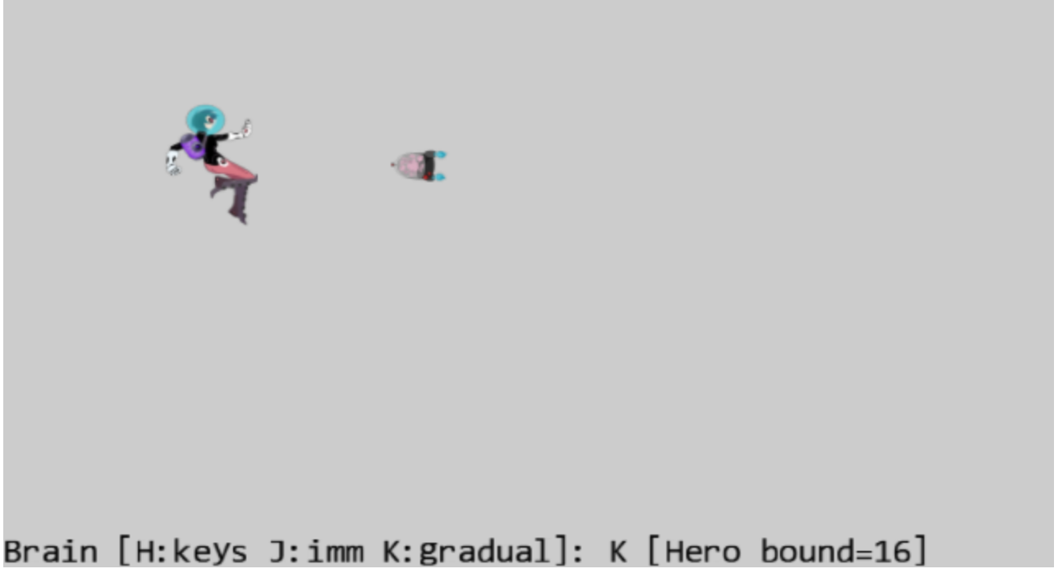
6.3: BBOX and Collision Project

Slide 39
6.3: Goals
understand bounding box and its implementation
experience working with bounding box of a GameObject
compute and work with the bounds of a Camera WC window
program with collisions

Slide 40
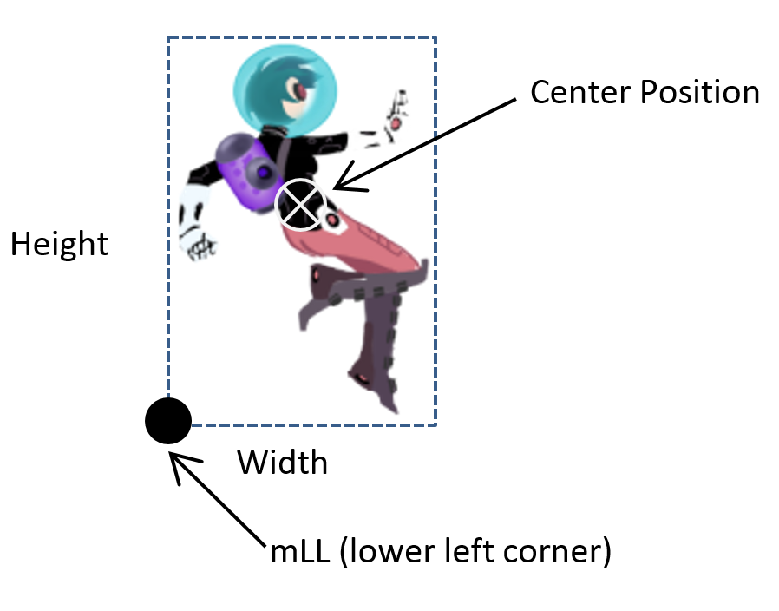
Bounding Box
Always major-axis aligned
4 floats in 2D
Point + Dimension
Center + W x H
Lower Left + W x H
2 points
Lower Left + Upper Right
“Easy” (efficient) to compute overlaps!!

Slide 41
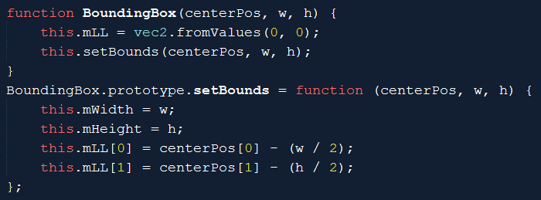
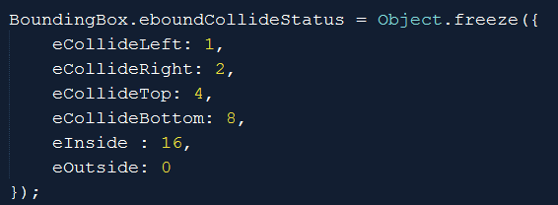
BoundingBox class

Slide 42
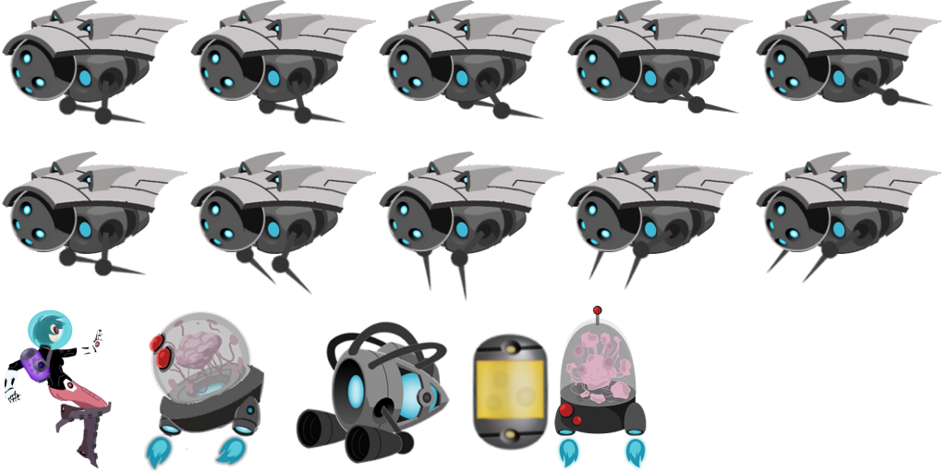
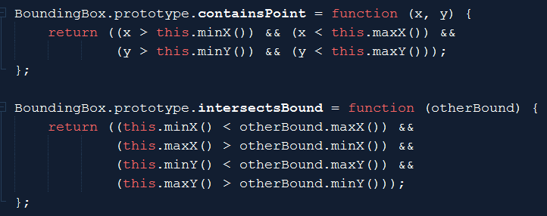
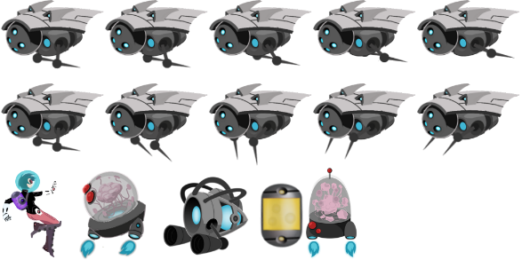
Bounds tests
(maxX, maxY)
(minX, minY)

Slide 43


Bbox: Collision status
eCollideRight
eCollideTop
eCollideLeft
eCollideLeft | eCollideBottom
eCollideBottom
eOutside

Slide 44

Using Bbox in GameObject
Design decision: compute on the fly!
Good:
No state to maintain (no need to update after xform change)!
Bad:
Not free to create
Bbox inquiry should be done no more than once per object per update

Slide 45

Using Bbox in Camera
Collide a xform with WCBounds
Zone: a percentage of WC Bounds
WC Center
eCollideLeft
Camera WC Bounds
zone
eOutside

Slide 46

Testing Bbox
Stop brain
Print status as a number:

Slide 47
Try
Hero bound status:
When outside?
What is 6?
How about 12?
If change the bound % from 0.8 to 0.2 what will happen?
Change the rate in MyGame
Try change from 0.02 to something much slower (like 0.001)
What will happen?

Slide 48
Try
Hero bound status:
When outside?
0
What is 6?
2+4 ➔top-Right
How about 12?
4+8➔Top-Bottom (tall object)
If change the bound % from 0.8 to 0.2 what will happen? ➔ easy for the object to be “outside”
Change the rate in MyGame
Try change from 0.02 to something much slower (like 0.001)
➔ Takes forever to turn towards the target

Slide 49
Try others
Change the rate in MyGame
Notice the tendency/potentials of “orbiting”
Increase/decrease Brain speed (Up/Down arrows)
To see different orbiting behaviors

Slide 50

Important limitation of Bbox
Axis aligned
Void space
Our implementation no support for rotation!

Slide 51

Problem with Bbox
We have seen: does not support rotation (at all!)
Even in the absence of rotation
Does not approximate collision well
Too much void space!
Collision: pixel overlaps!

Slide 52

6.4: Per Pixel Collisions Project

Slide 53
6.4: Goals
Derive per-pixel collision detection algorithm
Implement the algorithm
Understand the limitations and run-time complexity

Slide 54
Per-pixel accurate collision detection
Detect one of the non-transparent pixel overlaps
Good at answer: yes or no
BAD at answering: where
Does not answer: “first collision point”
Runtime:
VERY sensitive to image resolution (as expected)
VERY sensitive to which image collide with which!? ←

Slide 55

Colliding pixels of two images
Each of images, A and B are in WC space
Algorithm:

Slide 56


Algorithm: explained
Image-A, 6x5pixels
WC Size: 60x50
Lower-Left corner at WC (5,5)
Image-B, 3x4 pixels
WC size: 30x40
Lower-Left corner at WC (45, -15)

Slide 57
In WC:
WC origin: (0, 0)

Slide 58
In WC:
WC Space: (5,5)
WC origin: (0, 0)

Slide 59
In WC:
Width = 60
Height = 50
WC Space: (5,5)
WC origin: (0, 0)

Slide 60
In WC:
Width = 60
Height = 50
WC Space: (5,5)
WC origin: (0, 0)
WC Space: (45, -15)

Slide 61
In WC:
Width = 60
Height = 50
WC Space: (5,5)
WC origin: (0, 0)
Height = 40
WC Space: (45, -15)
Width = 30

Slide 62
WC Space: (65,55)
Image-A Pixel: (0,2)
WC: (10, 30)
Image-A Pixel: (5,1)
WC: (60, 20)
Image-B Pixel: (1, 3)
WC: (60, 20)
WC Space: (5,5)
Image-B Pixel: (2, 0)
WC: (70, -10)
WC Space: (45, -15)

Slide 63
WC Space: (65,55)
Image-A Pixel: (5,1)
WC: (60, 20)
Image-A space: pixel (5,1)
WC space: (60, 20)
Image-B space: pixel (1, 3)
Per-pixel collision Algorithm test
Image-A pixel (5,1) against
Image-B pixel (1,3)
Image-B Pixel: (1, 3)
WC: (60, 20)

Slide 64
The algorithm again
Image-A space: pixel (5,1)
WC space: (60, 20)
Image-B space: pixel (1, 3)
Per-pixel collision Algorithm test
Image-A pixel (5,1) against
Image-B pixel (1,3)

Slide 65
Per-pixel accurate collision: run time?
Runtime:
Worst case: O(W x H)
WxH is the resolution of Image A
Choose Image-A wisely!!
Collision between a small projectile (16x32) and the hero (128x64)!
Memory complexity?
CPU need to have access to color!
For both images!
O(W x H): of the larger image!
Expensive memory!

Slide 66
Questions
Given TextureRenderable-A
Texture resolution 10x20 texels
Xform: Position (15, 20), Size(20, 40)
P_{(7,9)} = The WC location of texel (7, 9), what is this?
In the same world, I have TextureRenderable-B:
Texture resolution 20x30 texels
Xform: Position (10, 10), Size(40, 60)
What is the (k, l) index of P_{(7,9)}
If, we replace all numbers with symbols:
Texture resolution: M_{A} x N_{A} , WC Locaiton/Size: (x_{A}, y_{A}) and, W_{A} x H_{A}
Texture resolution: M_{B} x N_{B} , WC Locaiton/Size: (x_{B}, y_{B}) and, W_{B} x H_{B}
Find (k, l) for each (i, j)

Slide 67
Questions
Given TextureRenderable-A
Texture resolution 10x20 texels
Xform: Position (15, 20), Size(20, 40)
P_{(7,9)} = The WC location of texel (7, 9), what is this?
Width of one texel in WC space: w_{t} =20 / 10 = 2
Height of one texel in WC space: h_{t} =40 / 20 = 2
In WC, Texel (7,9) is (7w_{t}, 9h_{t}) from the lower left corner of the Renderable
Lower-left corner of the Renderable: (15 – 20/2, 20-40/2) = (5, 0)
Texel (7,9) is (7w_{t}, 9h_{t}) + (5, 0) = (7*2, 9*2) + (5, 0) = (14+5, 18) = (19, 18)

Slide 68
Questions
Given TextureRenderable-A ➔ P_{(7,9)} is (19, 18)
In the same world, I have TextureRenderable-B:
Texture resolution 20x30 texels
Xform: Position (10, 10), Size(40, 60)
What is the (k, l) index of P_{(7,9)}
Lower-left corner of B is: (10-40/2, 10-60/2) = (-10, -20)
P_{(7,9)} distant from lower-left corner: (19-(-10), 18-(-20)) = (29, 38)
% size covered in X/Y: (29/40, 38/60) = (0.725, 0.6333)
Index (k, l): (0.725 x 20, 0.633 x 30) = (14.5, 19)

Slide 69
Questions
If, we replace all numbers with symbols:
Texture resolution 10x20 M_{A} x N_{A} texels
Xform: Position (15, 20) (x_{A}, y_{A}) , Size(20, 40) W_{A} x H_{A}
Width of one texel in WC space: w_{t} =20 / 10 = 2 ➔ w_{t} = M_{A} / W_{A}
Height of one texel in WC space: h_{t} =40 / 20 = 2 ➔ h_{t} = N_{A} / H_{A}
In WC, Texel (7,9) is (7w_{t}, 9h_{t}) from the lower left corner of the Renderable ➔ (ixw_{t}, jxh_{t})
Lower-left corner of the Renderable: (15 – 20/2, 20-40/2) = (5, 0) ➔ (x_{A}-W_{A}/2, y_{A}-H_{A}/2)
Texel (7,9) is (7w_{t}, 9h_{t}) + (5, 0) =
Texel(I, j): (ixw_{t}, jxh_{t}) + (x_{A}-W_{A}/2, y_{A}-H_{A}/2)
➔ Xposition: i * w_{t} + (x_{A}-W_{A}/2) or i * (W_{A} / M_{A} ) + (x_{A}-W_{A}/2)

Slide 70
Questions
Given TextureRenderable-A ➔ P is (x_{p}, y_{p})
In the same world, I have TextureRenderable-B:
Texture resolution 20x30 texels ➔ M_{B} x N_{B}
Xform: Position (10, 10) (x_{B}, y_{B}), Size(40, 60) W_{B} x H_{B}
Lower-left corner of B is: (10-40/2, 10-60/2) ➔ (x_{l} , y_{l}) = (x_{B}-W_{B}/2, y_{B}-H_{B}/2)
P_{(7,9)} distant from lower-left corner: (8.5-(-10), 4.5-(-20)) ➔ (x_{p}-x_{l}, y_{p}-y_{l})
% size covered in X/Y: (18.5/40, 24.5/60) = (x_{d} , y_{d}) = ((x_{p}-x_{l})/W_{B} , (y_{p}-y_{l})/H_{B})
Index (k, l): (0.4625 x 20, 0.4083 x 30) = (x_{d} * M_{B} , y_{d} * N_{B})
Index-K = x_{d} * M_{B} = (x_{p}-x_{l})/W_{B} * M_{B}= (x_{p}- x_{B}+W_{B}/2) * 1/W_{B} * M_{B}
= [(x_{p}- x_{B})/W_{B} + ½] * M_{B}

Slide 71


Store color in CPU:
Engine_Texture.js

Slide 72

TextureRenderable: caching info

Slide 73


TextureRenderable_PixelCollision.js
First detected position: no other meaning!
First detected position: no other meaning!

Slide 74


Index (Image Space) to WC
Image: Resolution: TexWidth x TexHeight
WC size: Xform.getWidth() x Xform.getHeight()
Texel width in WC = Xform.getWidth() / TexWith
WC location for pixel (i, j):
LowerLeft.x + i * Texel-Width-in-WC
LowerLeft.x = Xform.getXPos() – (Xform.getWidth() * 0.5)

Slide 75


WC position to Image pixel
normalizeSize (like UV): delta / WC-Size
Pixel-x = Image resolution * normalizeSize
wcPos
delta
Xform.getPosition()
(center of obj)

Slide 76
Remember, the algorithm

Slide 77


GameObject_PixelCollision.js
TextureRenderable_PixelCollision.js

Slide 78

Testing: per-pixel
Choice of the Image-A
Try changing “image-A”
MyGame.js update()

Slide 79
Per-Pixel Collision
Accurate Yes/No result
Cannot tell where (not well at least)
Computation cost:
O(Smaller image resolution)
Memory cost
O(Larger image resolution)
Can be costly!
Problem:
Does not support rotated image!

Slide 80


Vector Review: component & decomposition
Vector: $\overset{⃑}{V}$
Perpendicular component vectors:
$\hat{i}$ and $\hat{j}$
Decompose $\overset{⃑}{V}$ for components of $\hat{i}$ and $\hat{j}$
Component of $\hat{i}=\left(\overset{⃑}{V}∙\hat{i}\right)$
Component of $\hat{j}=\left(\overset{⃑}{V}∙\hat{j}\right)$
Always true:
$\overset{⃑}{V}=\left(\overset{⃑}{V}∙\hat{i}\right)\hat{i}+\left(\overset{⃑}{V}∙\hat{j}\right)\hat{j}$
Notes:
Give an example for form pixel to WC space.
Example from WC space back to pixel

Slide 81

With rotated component vectors …
Notes:
Use the same example for pixel to WC space, and WC space back to pixel

Slide 82


In our case:

Slide 83

6.5: General Pixel Collisions Project

Slide 84
6.5: Goals
Apply vector component and decomposition concepts to access pixels in rotated image
Derive and solve per-pixel collisions for rotated textured objects

Slide 85

The new pixelTouches function
Compute the rotated components: $\hat{L}$ and $\hat{M}$
By rotating the default X and Y component vectors: $\hat{i}$ and $\hat{j}$

Slide 86


Index (image space) to WC
(i, j)
xDir, yDir: $\hat{L}$ and $\hat{M}$
yDir
xDir
x y : (i,j) * pixel size in WC
xDisp/yDisp: distance to the center of object
Offset from center of object along xDir/yDir

Slide 87

WC to image space (index):
wcPos
Old way: decompose assuming x/y components
yDir
xDir
New way: decompose explicitly with dot products
No change!

Slide 88


GameObject: Bbox test!
myR
myR
mySize[0] [1]

Slide 89
Where are we?
Per-pixel accurate collision algorithm implemented
Reviewed vector component and decomposition concept
Support rotated textures for per-pixel accurate collision
Last refinement: Support for Sprite Elements

Slide 90

6.6: Sprite Pixel Collisions Project
Goal: generalize per-pixel for sprite elements

Slide 91

All a matter of reference position: the origin
A Texture
Given index (i, j): offset from the “Origin”
For TextureRenderable: Offset
Offset reference is: (0,0)
For SpriteRenderable:
Offset reference is lower-left corner
Index (i, j)
i-^{th} and j-^{th} pixel with respect to lower-left corner, or (0, 0)
A Sprite Element
A Sprite Sheet
Index (i, j): identifies a pixel with respect to the lower-left corner of element and not (0,0)

Slide 92

SpriteRenderable_PixelCollision.js
Record sprite information: lower-left corner and size
Index of lower-left corner of current sprite element
mTexWidth/Height: size of sprite element (instead of the entire texture).
mTexWidth and mTexHeight: are used throughout TextureRenderable, SpriteRenderable, and SpriteAnimateRenderable.

Slide 93



Ensure to use sprite lower-left corner and size

Slide 94

Use the information during color lookup!
Index of texel for alpha look up
mTexBottomIndex/LeftIndex: are initialized to (0,0) for TextureRenderables

Slide 95
Ultimate test of per-pixel collision:
Hero/Brain:
SpriteRenderable
SpriteRenderable
Test for support of all Texture sub-classes
L/R/H/B: Colide with Portal
Brain: chase Hero
Minions: SpriteAnimateRenderable
Portal: TextureRenderable

Slide 96
Chapter 6: What did we learn?
Review vectors: size, direction, dot/cross, component, decomposition
Applying simple vector concepts
Chasing, Position calculation for pixels on rotated textures
Importance of GameObject
MyGame clear of specific object updates
MyGame can focus on inter-object relationships
Boundingbox: cheap, lousy accuracy, useful as a rough test
Per-Pixel accurate collision detection
For rotated images, for sprites,

Slide 97
Per-Pixel Accurate Collision
Costly: both computationally and memory-wise
Computation: O(smaller image)
Memory: O(larger image)
Functionality:
Yes/No answer to collision: very accurate! (at pixel level!)
Does not provide much insights into collision position
e.g., no support for first point of contact (difficult problem in general)

